Slide 1
Graph Plots of the MVS 2.0.0
By
Saurav Thakur

Slide 2
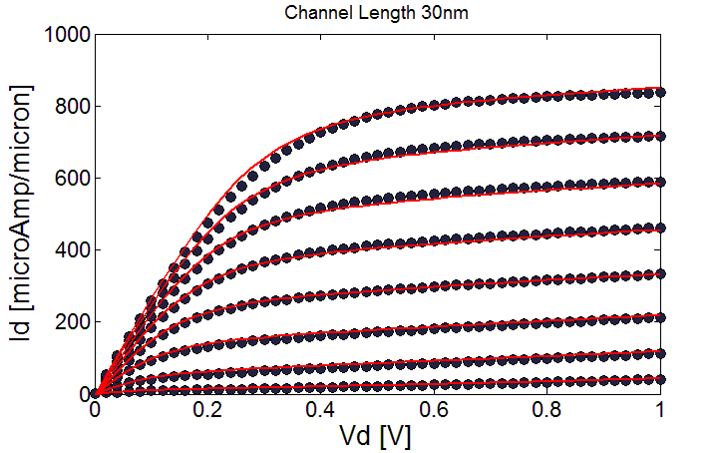
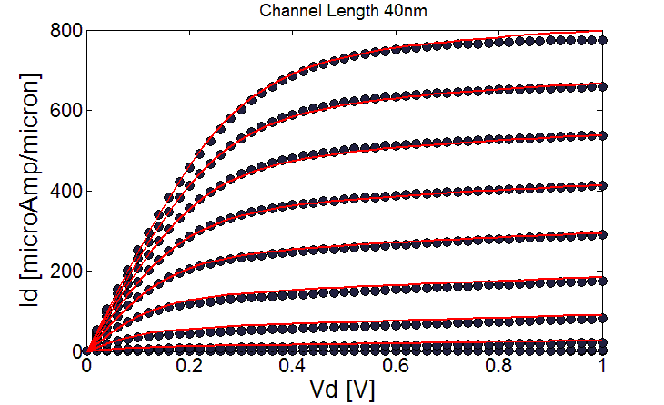
ET-SOI Plots of Id vs Vd
Increase in channel length results in decrease in current for same Vds and Vgs due to decrease in transmission but saturation current isn’t much dependent on Vd

Slide 3
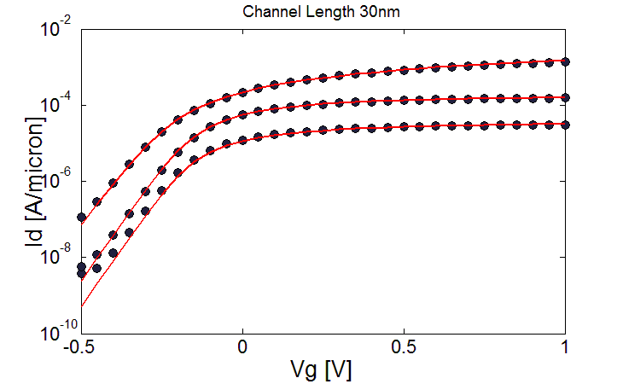
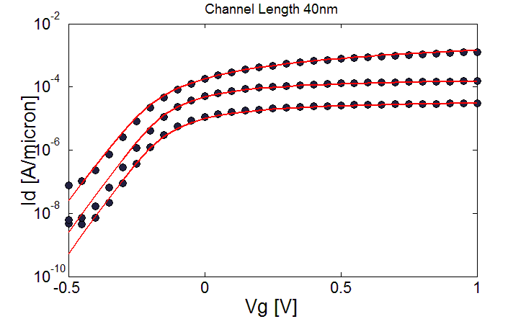
ET-SOI Plots of Id vs Vg
DIBL and subthreshold swing is lowered at higher channel length

Slide 4
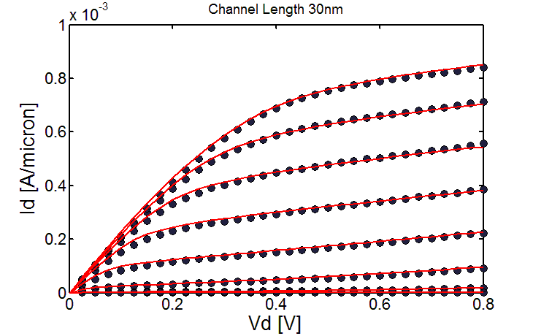
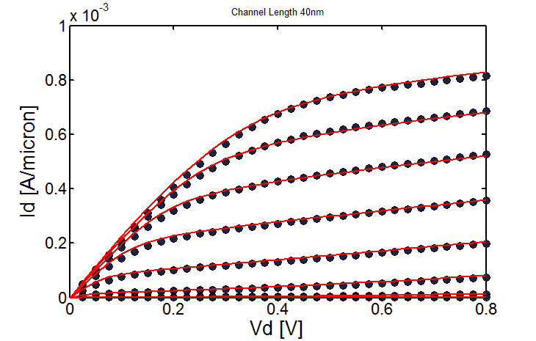
HEMT Plots of Vd vs Id
Increase in channel length results in decrease in current for same Vds and Vgs due to decrease in transmission and saturation current is dependent on Vd although this effect too decreases with increase in channel length

Slide 5
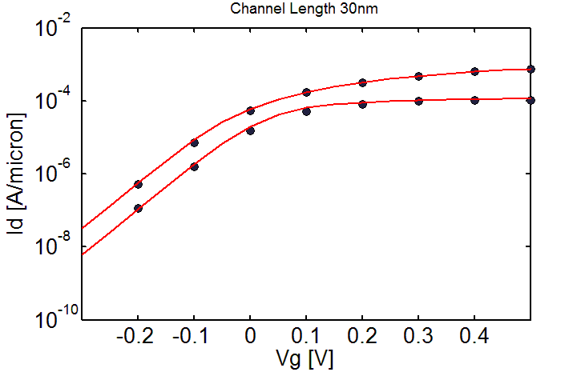

HEMT Plots of Vg vs Id
Decrease in DIBL can be observed

Slide 6
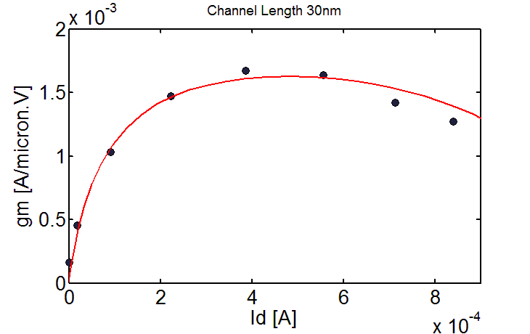
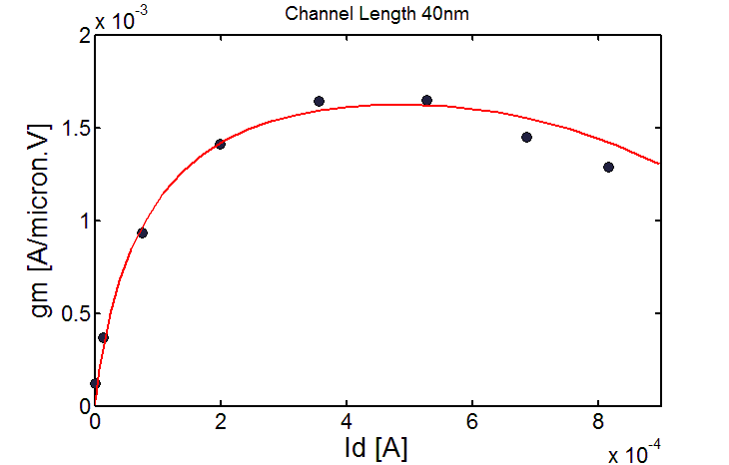
HEMT Plots of Gm vs Id
First the conductivity increases as the current increases before reaching saturation
We see a drop after the saturation of mobility as we have considered series resistances to be current dependent which increases with it and hence at higher current we see this unusual drop

Slide 7
THANK YOU

